Slide 1
Retail Promotion Management System
Caselet for React JS Advance Concepts (React JS + Redux + API Integration)
SepTember 2021
Estimated Efforts: 80 hours

Slide 2


Introduction
This caselet will be focusing on creating a React web application which will be ready to use for the retailers to manage their promotions.
What is retail promotion management?
Retail promotion management system, catering to the need of managing promotions across the calendar with prediction over how a future promotion will perform and visibility of impact of past promotions over sales, margin and volume uplift.
Primary Focus of this Web Application will be on:
Customers
Sales
Brand
Products
Historic
Promotions

Slide 3





Prerequisite knowledge on few techniques and familiarity with domain solicited
HTML/CSS
JavaScript
ReactJS
Redux
HTML(Hypertext markup language) and CSS(Cascading style sheets) are two of the core technologies for building Web pages.
HTML provides the structure of the page and CSS provides the visual layout.
JavaScript is a scripting language that enables you to create dynamic pages.
ReactJS is an open-source declarative, efficient and flexible JavaScript library for building user interfaces specifically for single-page applications.
It also allows us to create reusable UI components.
Redux is an open-source JavaScript library for managing application state. It maintains the state of entire application in a single immutable state tree which can't be changed directly.
Grammar & Types | Functions
Object Oriented Programing | Promises
Data Structure-1 | Data Structure-2
Data Structure-3 | Modules
React Basics & JSX | Components & props
State & Life cycle | Rendering Elements
Overview | Core-Concepts
Other links | Ecosystem
Tutorial Link 1 | Tutorial Link 2

Slide 4
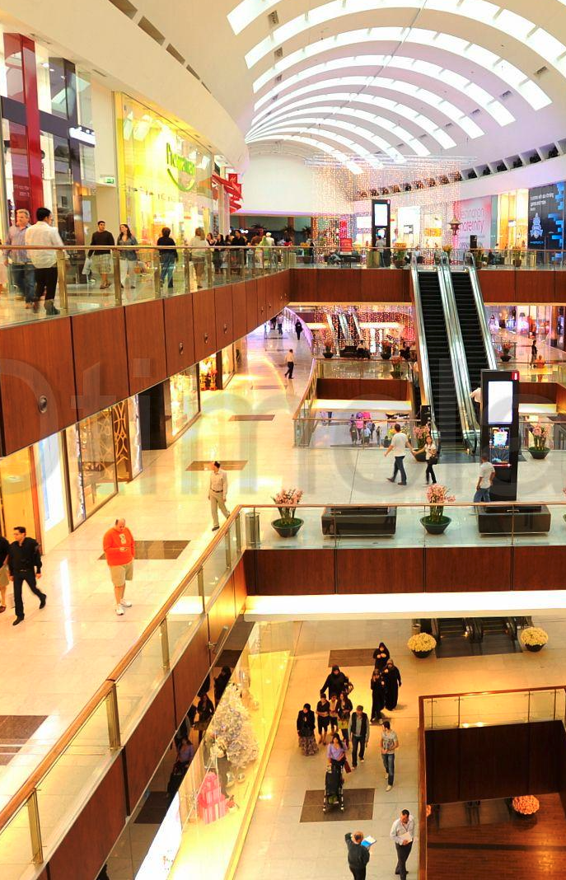
Client context:
Our client is a France based retailer and they want to create a tool which enables them to optimize promotions across the calendar with prediction.
This tool will also give the power to easily and accurately
plan successful future promotions, incorporate their
impact to the overall retail planning process and
evaluate their Effectiveness.
Impact:
This solution supports intuitive UI for retailers to decide promotion calendar and simulate the best optimized calendar to maximize sales or profit.
This solution supports intuitive UI for retailers to decide promotion calendar and simulate the best optimized calendar to maximize sales or profit.

Slide 5
Exercises
In this Caselet, we will be focusing on how we consume REST API's in the react application using Redux and mimic and Offline Application behavior.
Sub-Exercises:
First, You will have to run the backend (Python-Flask application) which we have provided along with the Caselet. To run the backend on your local, there is a README.md file which you can follow and after that you can use the REST APIs on the ReactJS application.
In order to consume APIs, ReactJS app must send any “Dummy Token” in “Authorization” Header.
Reference Link-1
Reference Link-2
While consuming APIs in application, ensure proper “Error Handling”.
If you are not getting data from the API's so in that case, you will have to take the dummy data from the “Redux” store which you have saved.
If APIs are returning data, continue on building the screens given in the following exercises.

Slide 6
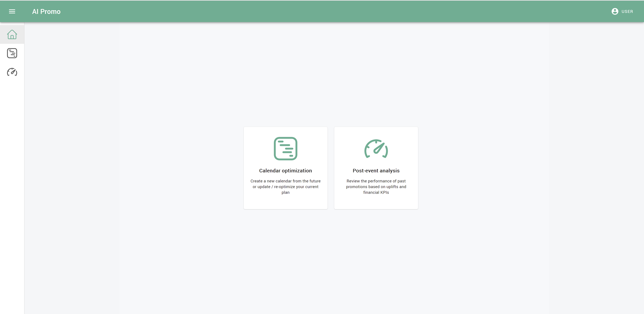
Exercise (1a)
Following is the home screen of the tool which shows navigation items to go to:
Calendar Optimization screen
Post event analysis screen
Here, we will be focusing on the routing concepts of the React.

Slide 7
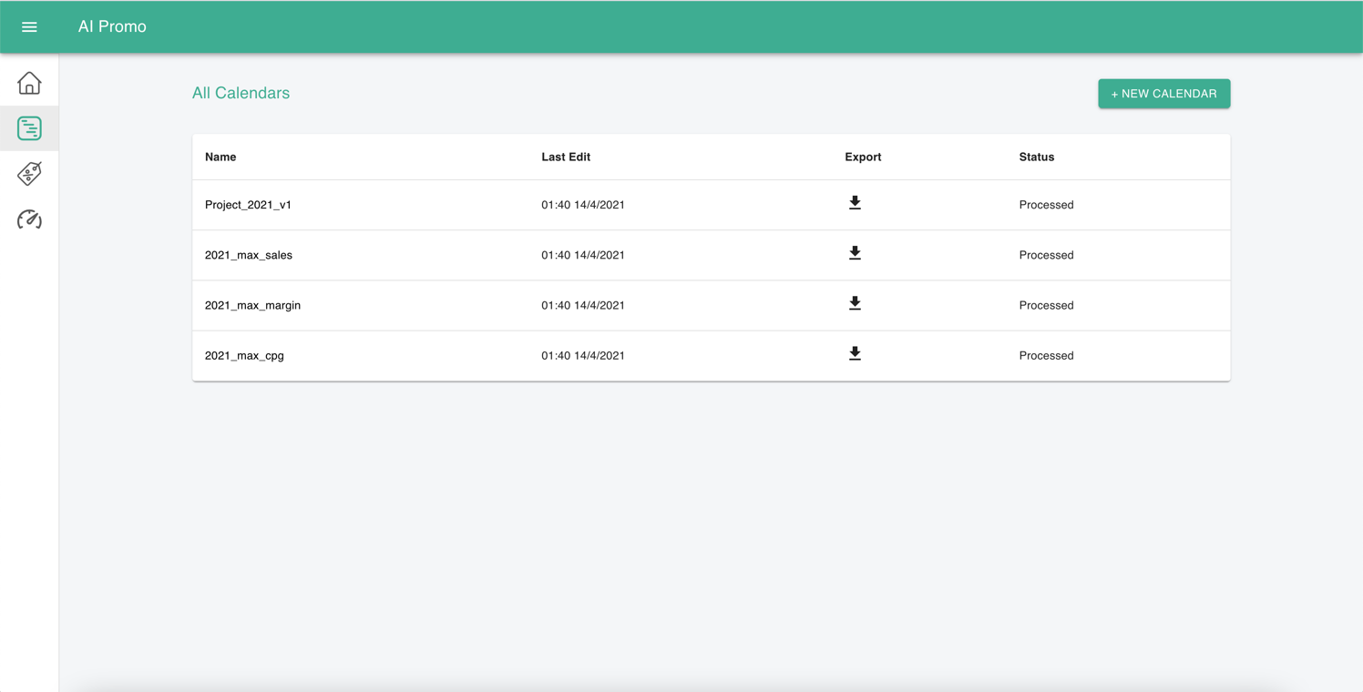
Exercise (1b)
Calendar Optimization View
On this screen, user can view all optimized calendars and can add a new calendar by clicking on +New Calendar button.
Here, we will be focusing on creating tables and adding new entity in the table by clicking on add new calendar button

Slide 8
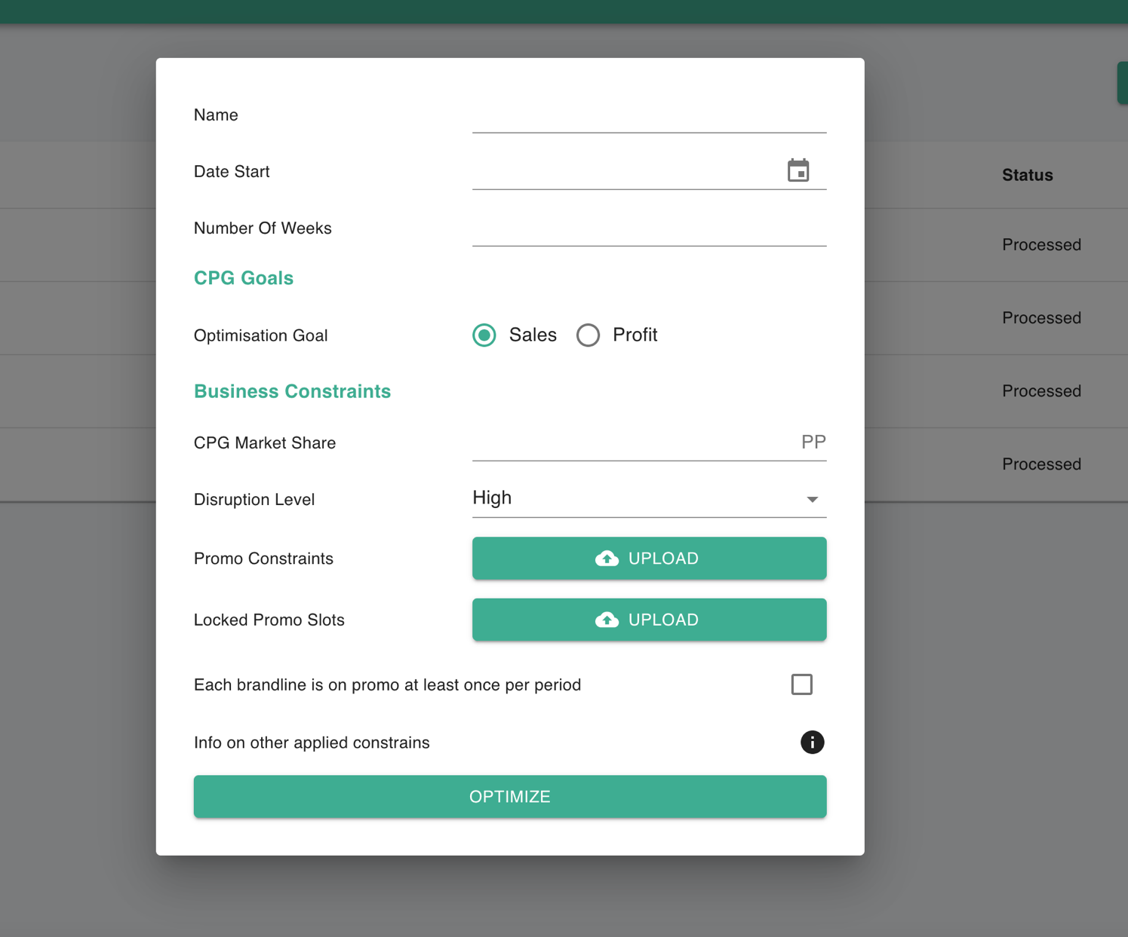
Exercise (1c)
Add New Calendar
This popup is used to add a new calendar
Here, we will be focusing on adding modal dialogs/ pop-up screens.

Slide 9
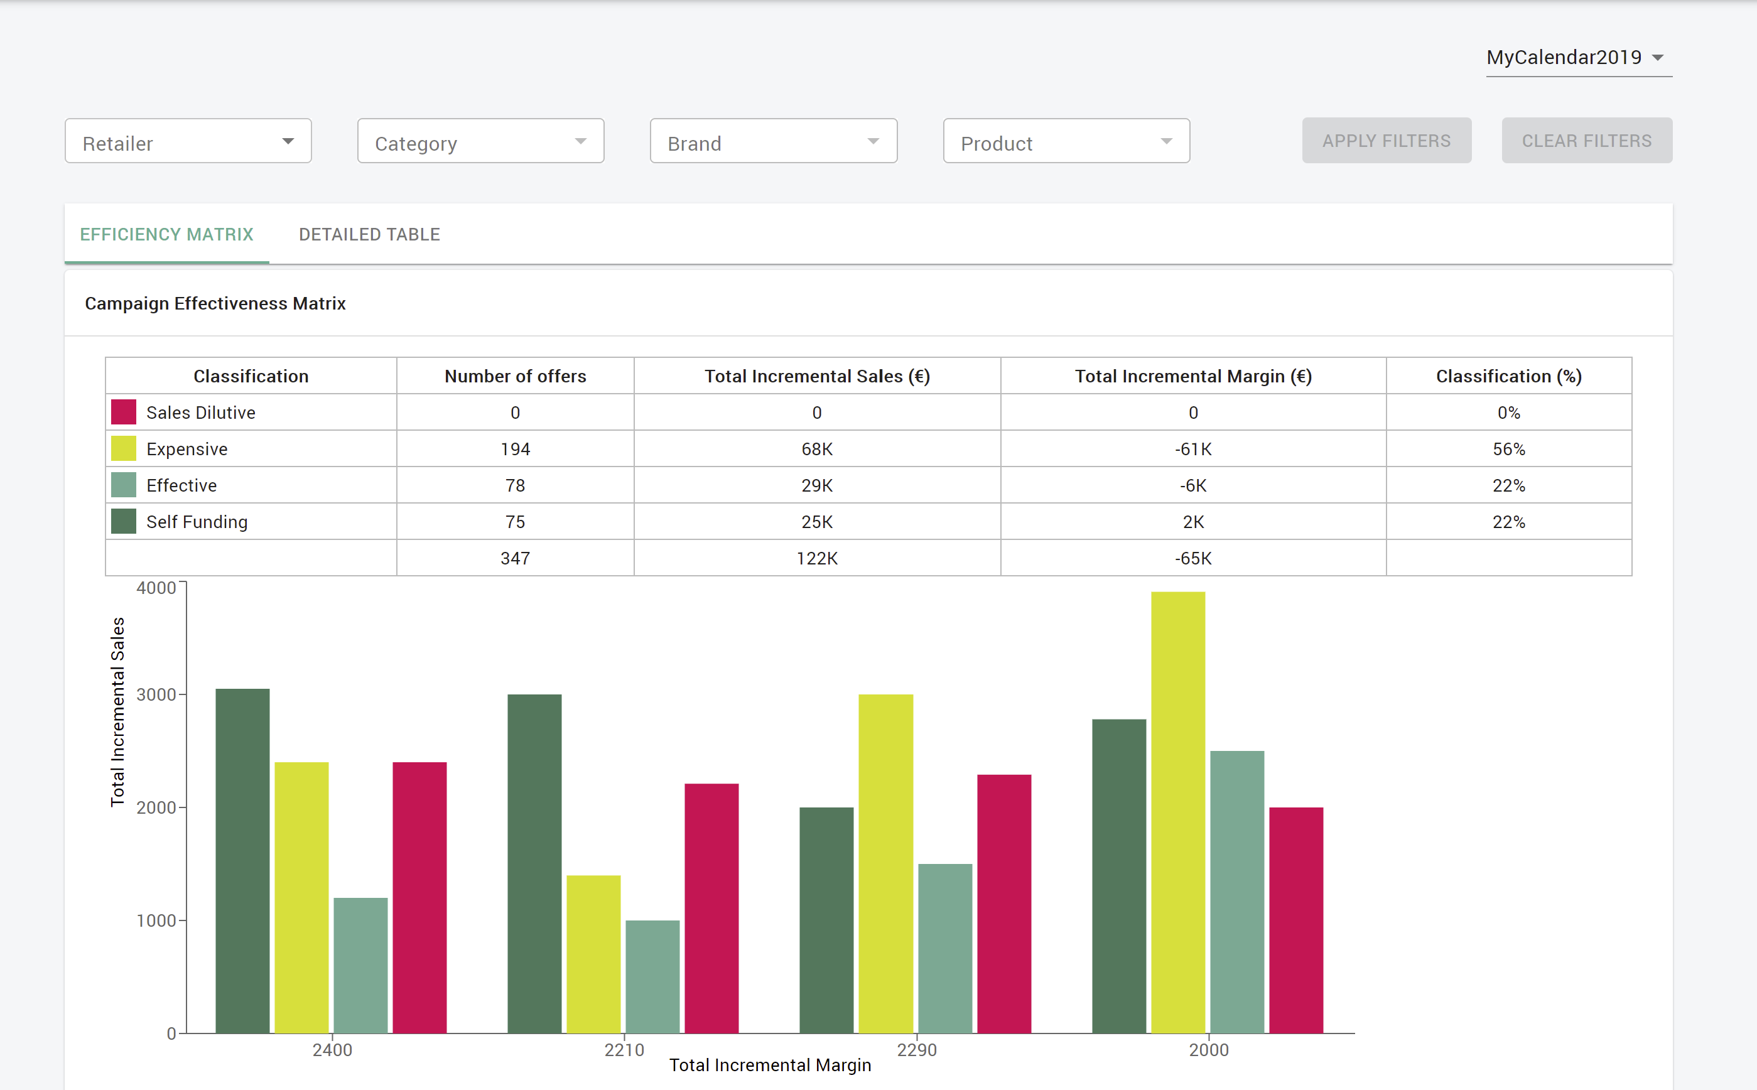
Exercise (1d)
Analysis View
On this screen we have the functionality to filter promo events based on retailer, category, brand and a product and see analysis Efficiency Matrix Tab.
Here, we will be focusing on populating data into table and visualization part using graphs.

Slide 10
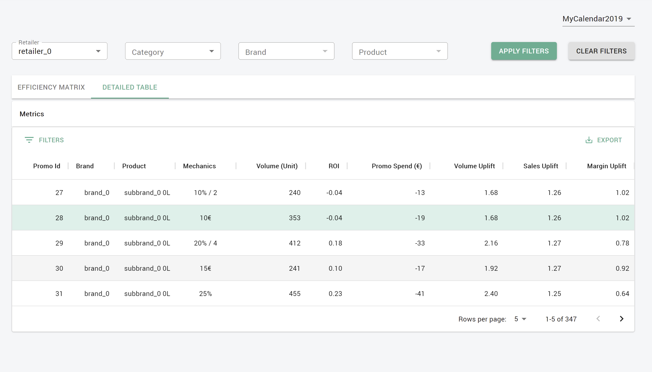
Exercise (1e)
Detailed Table View
Table with all selected promo events.
Here, we will be focusing on filtering the table data, sorting and pagination part

Slide 11
Datasets available
Data file Name / API Path | Data Definition
reference_calenders_dummy_json or http://localhost:5000/api/v1/reference-calendars | Will contains data for calendar which includes name and status of the calendar and used to populate calendrer dropdown in Exercise (1e)
calenders_json or http://localhost:5000/api/v1/calendars | Contains all data which is used to populate calendar optimization view i.e. Exercise (1b)
products_json or http://localhost:5000/api/v1/products | Contains all data which is used to populate dropdowns for Retailer, category, Brand and Products in the post event analysis section i.e. Exercise (1e)
campaign_effectiveness_json or http://localhost:5000/api/v1/campaign-matrix | Contains all the data used to populate campaign effectiveness matrix in Exercise (1d)
detailed_table_data.json or http://localhost:5000/api/v1/detailed-table | Contains all the data used to populate detailed table in the post event analysis section i.e. Exercise (1e)
Dummy Data files are present on the same directory. You can use the same if you are not getting data from the APIs while creating different sections of the web application for the caselet or you can create your own dummy json data as per the views.

Slide 12


Best Practices
Keep components small and function specific. (Help)
Reusability is important, so keep creation of new components to the minimum required. (Help)
Consolidate duplicate code - DRY your code.(Help)
Comment only where necessary.(Help)
Name the component after the function.(Help)
Use capitals for the component names.(Help)
All files related to any one component should be in a single folder.(Help)

Slide 13

Contacts
Topic Experts
Mearaj Ali (Ali.Mearaj@bcg.com)
Rakesh Gauniyal (Gauniyal.Rakesh@bcg.com)
Author of Caselet
Rakesh Gauniyal (Gauniyal.Rakesh@bcg.com)

Slide 14

Naming convention:
CaseletName_Last_FirstName
Communication:
Use Slack channel
Ensure you have Slack on mobile device
Outputs:
Do version control and share only final version
Typical savings across transformations
Best Practices
Check-in Calls:
Use this as a platform to clear any doubts
Request for call with SPOC/expert if needed
Share:
Use send.bcg>2Mb
Share link on email with explanations as needed
Deadline:
In the unavoidable case of being pulled on case/
any anticipated delay; raise an early alarm
When in doubt… ASK !!!

